Slide 1
Access Monitoring and Alert for construction mechanic
Name : Tang Wing Kwong (Ken)

Slide 2
LoraWAN Features
Low power (The battery may enough to use for up to 10 years)
Star topology (Multiple end devices communicate with single Lora Gateway)
Strict communication constraints, include
< 1% duty cycle transmission
< 30 s uplink airtime per day
< 10 packets downlink per day

Slide 3

Construction Mechanic

Slide 4
System Overview
Construction Site Monitoring System
Mechanic Monitoring
(Ken)
Worker Monitoring
(Eric)
Environmental Monitoring
(Alvin)

Slide 5
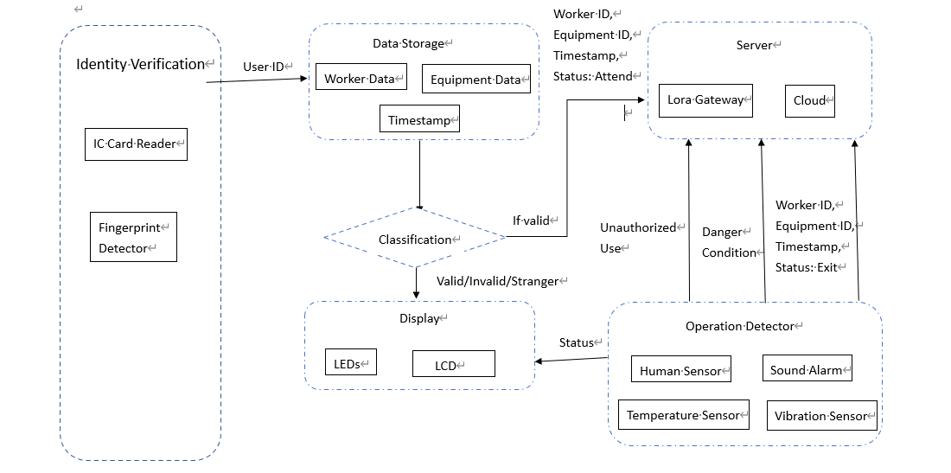
System Overview (Machine Monitoring)

Slide 6
Identity Verfication
To identify the identity of user, can have multiple way that have different feature
Password lock : Easy to implement and use but can be shared, need to memorize
IC card : Easy to implement and use, low power but can be shared
Fingerpaint : Not exchangable feature and low power but not easy to use
Face recognition : More automative, handy but high power consumption
RFID : low power consumption, for higher RF can up to 200m detection distance

Slide 7
Identity Verfication
Consideration : The heavy construction equipment required worker trained before operating
Therefore, it should make sure it operated by right person. Using the fingerprint is a suitable
way to ensure unauthorized people operate the equipment.
However, for some less restricted equipment or place, IC card reader will be better as it easy
to use and lower monitoring level.

Slide 8
Display
To visualize different type of informations
Information include : Verfier name, valid or not valid, operating status, warnings…
Minimum solution : Using LED to indicate the user valid or not, machine ON or OFF
Better solution : Use LCD screen to display more detailed informations

Slide 9
Operating Detection
Include function of sensing occupicy of operator and the operation status of equipment
The human sensor is to detect the operator is inside the operating zone or not
If the human sensor sense a low occupcicy for a period of time (> 30 s), assume the operator
exit operation region, send data to server to notify the worker end the work
The temperature , vibration or other sensor is to determine the machine ON or OFF, dependent
for different machine
An extreme value or ON status while no operator will trigger alarm system
because it indicate the operator don’t place the machine safe or the machine have real fault

Slide 10
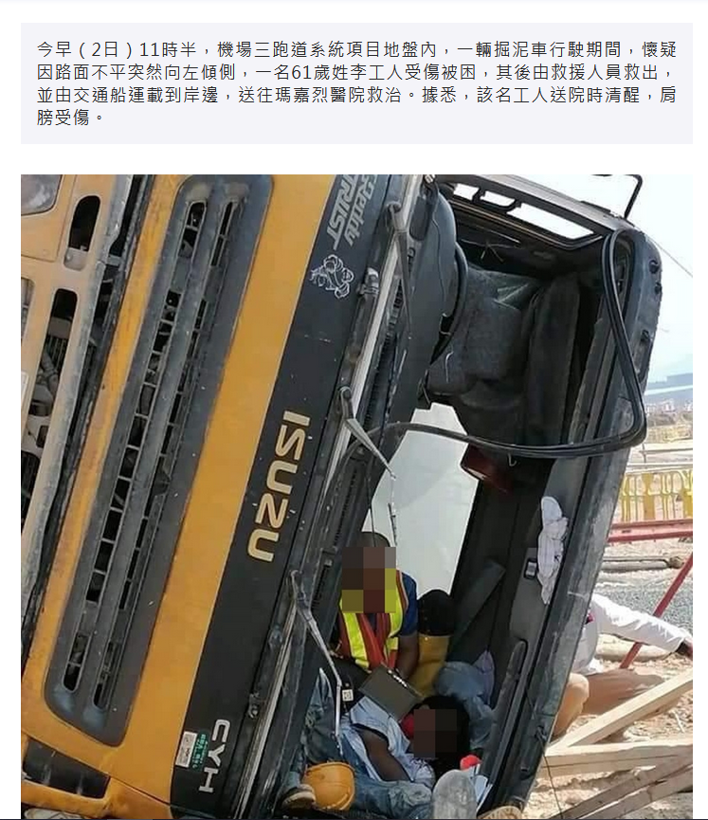
Danger Condition Example
Car Slippery
Can be detected by accelermetor sensor

Slide 11
When to send data
Someone attended to the equipment
The verified attender exit or release the equipment
Unverified/disqualified/unknown person use the equipment
Unusual or extreme value measured by sensors that indicate incident or machine failure

Slide 12
Benefits
Non-repudation feature
This feature unlike safety harlmet or IC card, can be exchanged from person to person and thus someone may pretend as another. This feature must follow the person so can avoid this problem.
More precise equipment usage management
It can know who use the equipment, which equipment the people using, when to use, how long to use
High computivity
It can installed for most equipment, with human sensor and suitable sensor detect usage
Topic Focused
Mainly using sensor and communication , no depth magnetic and mechanic knowledge required.

Slide 13
Expected Limtation
Time required to identify and compare the finger paint
Time required to send data (attendance/alert)
Fingerpaint database capacity for the device
e.g For the AS608 fingerprint model , it maximum capacity is 300
Battery life time to power the module (in order to be wireless and portable)
Need to insert to power supply or switch
If can’t insert/replace to switch, no ON/OFF access control for the equipment
But occurpy monitoring and alert still possible
Assume only one person using the machine

Slide 14
Reference
1.
https://theconstructor.org/construction/heavy-construction-equipment-types/26305/
2. Construction Site and Heavy Equipment Monitoring
https://www.monnit.com/applications/construction/
3. AS608指纹模块 光学指纹识别 有51/STM32/rduino例程 指纹锁考勤
https://detail.tmall.com/item.htm?spm=a312a.7700824.w4011-22005753285.46.5348310cJYefZ7&id=602239771749&rn=fc898d5ddd38a0e3f5e96cda0911fa8b&abbucket=5
4. Access to construction sites
https://www.designingbuildings.co.uk/wiki/Access_to_construction_sites

Slide 15
Reference
室內外應用的資產跟踪解決方案
https://inno.emsd.gov.hk/tc/it-solutions/index_id_1096.html
Integrating automated data acquisition technologies for progress reporting of construction projects
https://www.sciencedirect.com/science/article/pii/S0926580510002098?casa_token=M6BlsES_biIAAAAA:f2L1BS_KEj2SwY4RNL8433lMGXBOaSfTx1VTlfjt7ygXFwETP-FN0434hmqfP5VmvG6NmoFWmw
3.

Slide 16
Finger Paint Sensor Module
AS608数据手册：（出厂默认波特率57600）
链接：https://pan.baidu.com/share/init?surl=cRzX3MopkehOdM-BSlQrUg
提取码：pujp
AS608指纹模块资料：（例程波特率57600）
链接：https://pan.baidu.com/s/1tGJfDuYghOZxdy1X4rWd4A
提取码：xhhs
AS608指纹模块+STC89C52底板+1602液晶（例程波特率57600）
链接： https://pan.baidu.com/s/1MrdwBs81RAScuGgS5YSeiw
提取码：hqct

